Slide 1
Sons of God Most High
Embrace Great Destiny
Gen 14:9 & Gal 4:1-9
19/02/17

Slide 2
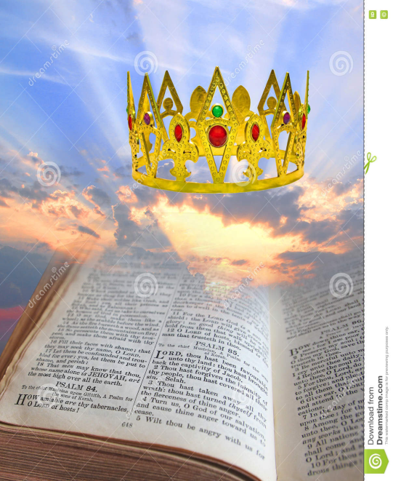
DO NOT DESPISE SMALL BEGINNINGS
DESIRE CHANGE AND PROCESS
EMBRACE GREAT DESTINY .

Slide 3
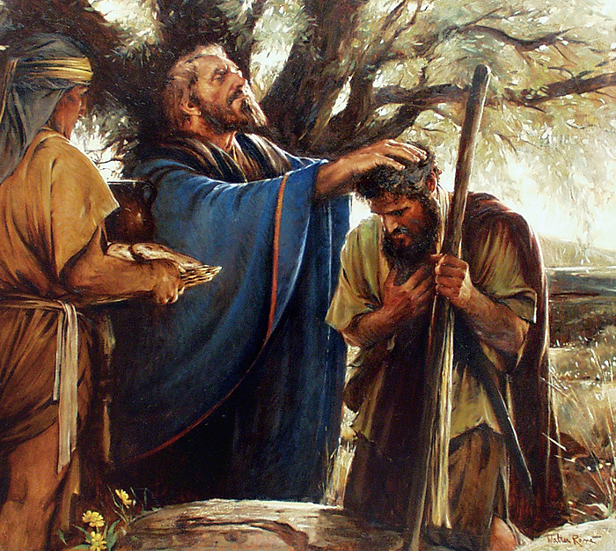
Gen 14:19-20
And he (Melchizedek)blessed him (Abram)
and said:
“Blessed be Abram
of God Most High,
Possessor of heaven
and earth;
And blessed be God Most High,
Who has delivered
your enemies into
your hand.”

Slide 4
“Blessed be Abram”
a) God desires to bless us (Eph 1)
- God blesses us with purpose.
- God desires to bless us so others are touched.
- We are God’s choice instrument to affect the life of others around us with the Holy Spirit empowering us from the inside
Rom 8:19 - For the earnest expectation of the creation eagerly waits for the revealing of the sons of God.

Slide 5
“of God Most High”
b) We are of God Most high
– We are sons of the King of kings (therefore we must think like a prince!)
Our God is a great God with great plans for His Church (Eph 1:22-23)
And he put all things under his feet and gave him as head over all things to the church, which is his body, the fullness of him who fills all in all.

Slide 6

Sons inherit the Kingdom
When do we inherit? NOW!
Kingdom of God is like seeds.
When receive seeds we become seeds.
-Wherever we are we are to affect others.
Don’t have a “fruit” mentality
- Seed have potential to multiply
- A seed → A fruit?

Slide 7
Gal 4:1-9
⁷ Therefore you are no longer a slave but a son, and if a son, then an heir of God through Christ.
⁸ But then, indeed, when you did not know God, you served those which by nature are not gods.
⁹ But now after you have known God, or rather are known by God, how is it that you turn again to the weak and beggarly elements, to which you desire again to be in bondage?

Slide 8
a) We are known by God
He knows our capacity, our potential, our destiny. Do we?
Eph 2:10 For we are His workmanship, created in Christ Jesus for good works, which God prepared beforehand that we should walk in them.
We are sons of the High King, we have the royal blood in us!
Luke 2:52 - Rise in stature
- We are made for the palace not the street
- The standard of our life must match

Slide 9
b) Don’t turn back again
Do not turn back to the comfy zone.
Bondage may feel comfortable.
E.g. Israel desire to go back to Egpyt.
Num 14:3,4 Why has the Lord brought us to this land to fall by the sword, that our wives and children should become victims? Would it not be better for us to return to Egypt?” So they said to one another, “Let us select a leader and return to Egypt.”

Slide 10
Conclusion
It is not too late to start growing.
(Reset button!)
Do not take training, teaching lightly (There is no limit….)
Connect to the vision of the House
- Individual responsibility
- Corporate anointing
- Corporate fulfillment

